Slide 1

Dan Sartoris Data Visualization Examples
Not classified or subject to non-disclosure agreements

Slide 2

Pandemic Job search Dataset
Notes:
RAFAEL
Historically, charges with new merchants or in new locations were an indicator for potential fraud. This was supported by older literature and common, albeit out-of-date business practice. However, as the world economy becomes increasingly online and distributed this is now seen as less of a red flag. In today’s globalized economy, new charges from a new vendor are often just an indicator that a customer is trying something new for the first time. In instances where criminals have initiated a fraudulent transaction with a new vendor where it is approved, those same malicious actors are now more likely to exploit that channel again and again until circumstances close off that opportunity. This helps explain why the repeat-vendor predictor is not statistically significant.
NEXT UP: DAN

Slide 3
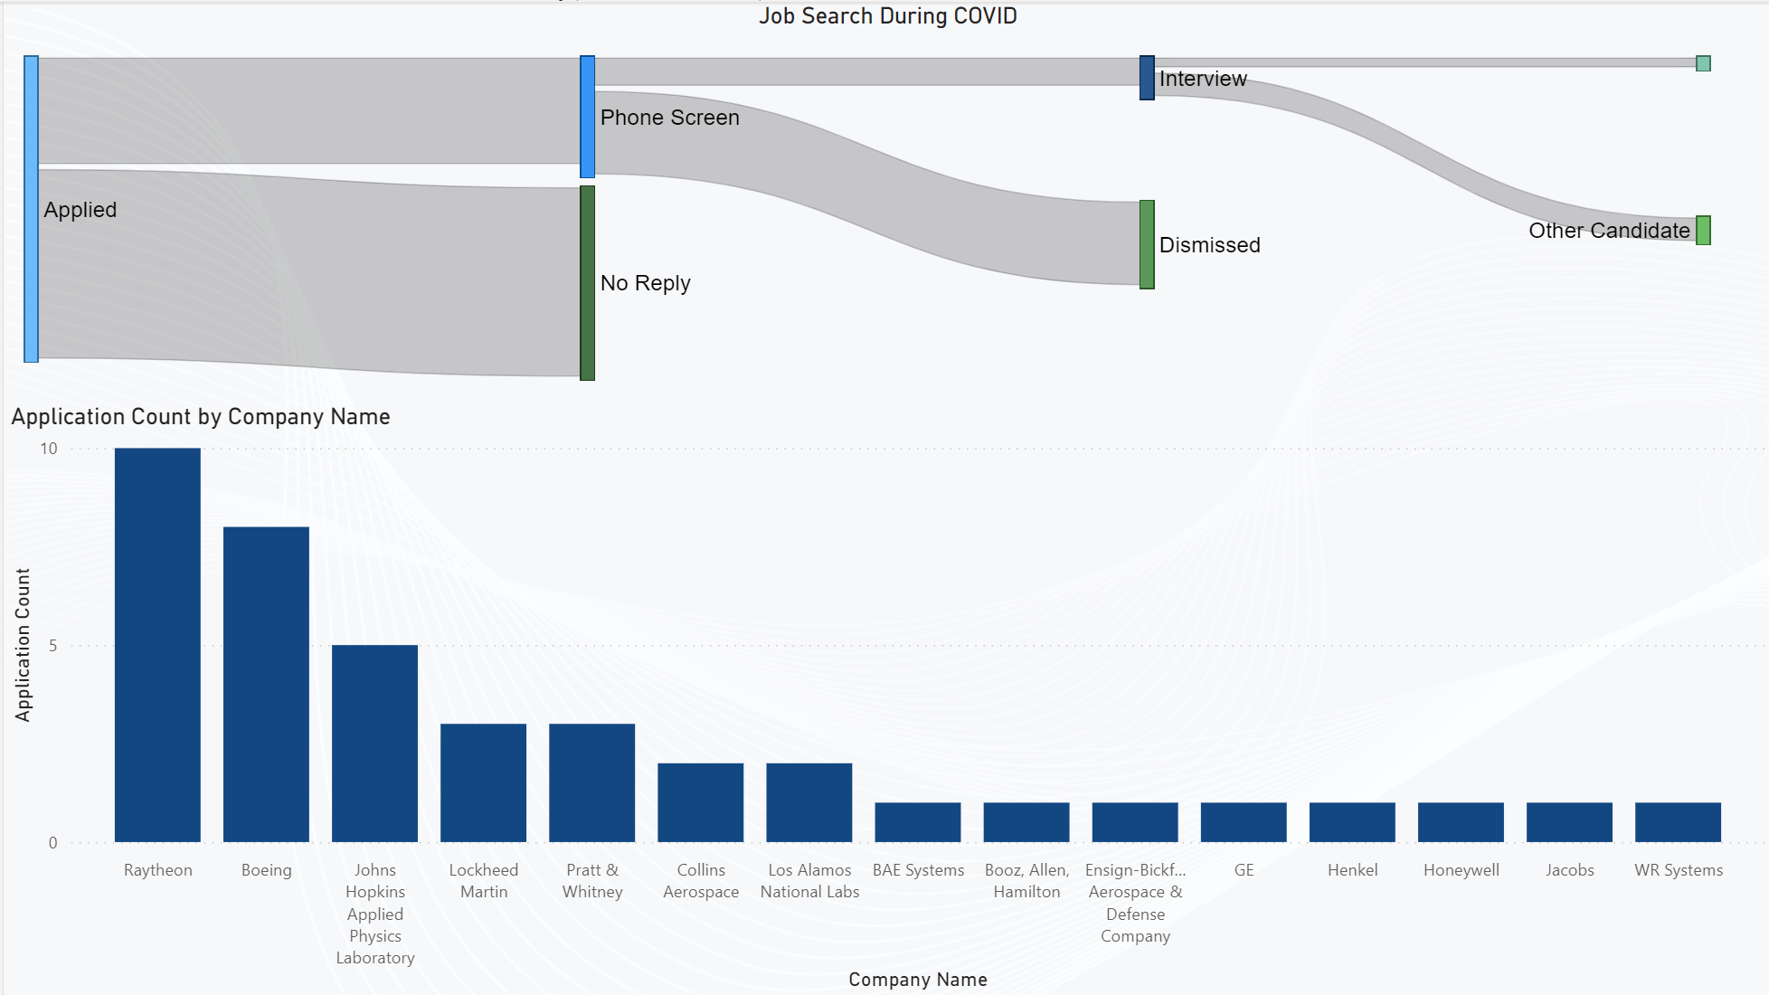
My Pandemic Job search – Power bi
-In a time of great uncertainty and high unemployment, finding a new job can prove to be extremely difficult
-I kept meticulous notes on my job applications from Oct 2020 to Dec 2020. I declined interviews offered after December.
Job offer from Northrop Grumman!

Slide 4


Sales Dashboard
Notes:
DAN F
If we had more resources at our disposal, we would invest in creating a neural network to catch post-transaction fraud given that the current credit card processing ecosystem allows for a matter of hours, if not days, to catch this fraud. Based on an NIT study of credit card detection models, the highest performing models are ensembles that leverage Neural Networks, whose creation is beyond the scope of this course and this team’s current capabilities. For example, the NIT paper found that fuzzy clustering with neural networks achieved a 93.9% TP rate and less than a 6.10% FP rate. More complex approaches to classification can be more beneficial than our present approach.

Slide 5
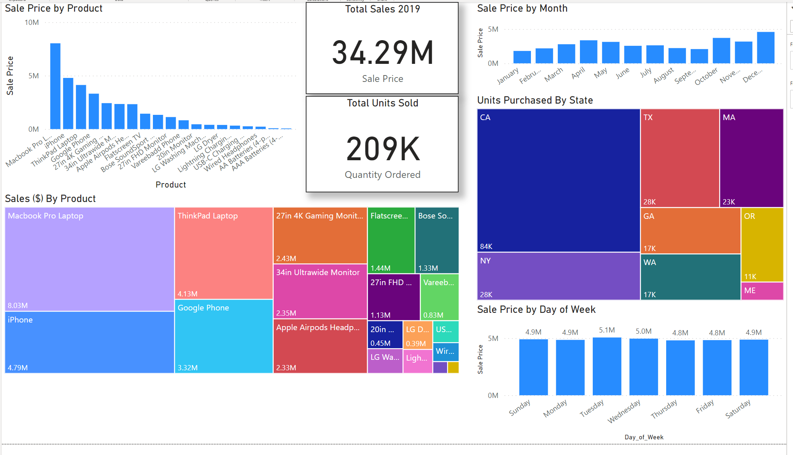
Kaggle Sales Data – Power BI
-With more time, I would like to add further breakdowns by component to see if any items are frequently bought together as well as who the top 5 customers are and what they purchased.
Highest sales in December, as expected. October sales higher than November surprising.
Sales peak on Tuesdays with Thursdays and Fridays being the slowest days
Source: https://www.kaggle.com/datasets/knightbearr/sales-product-data

Slide 6
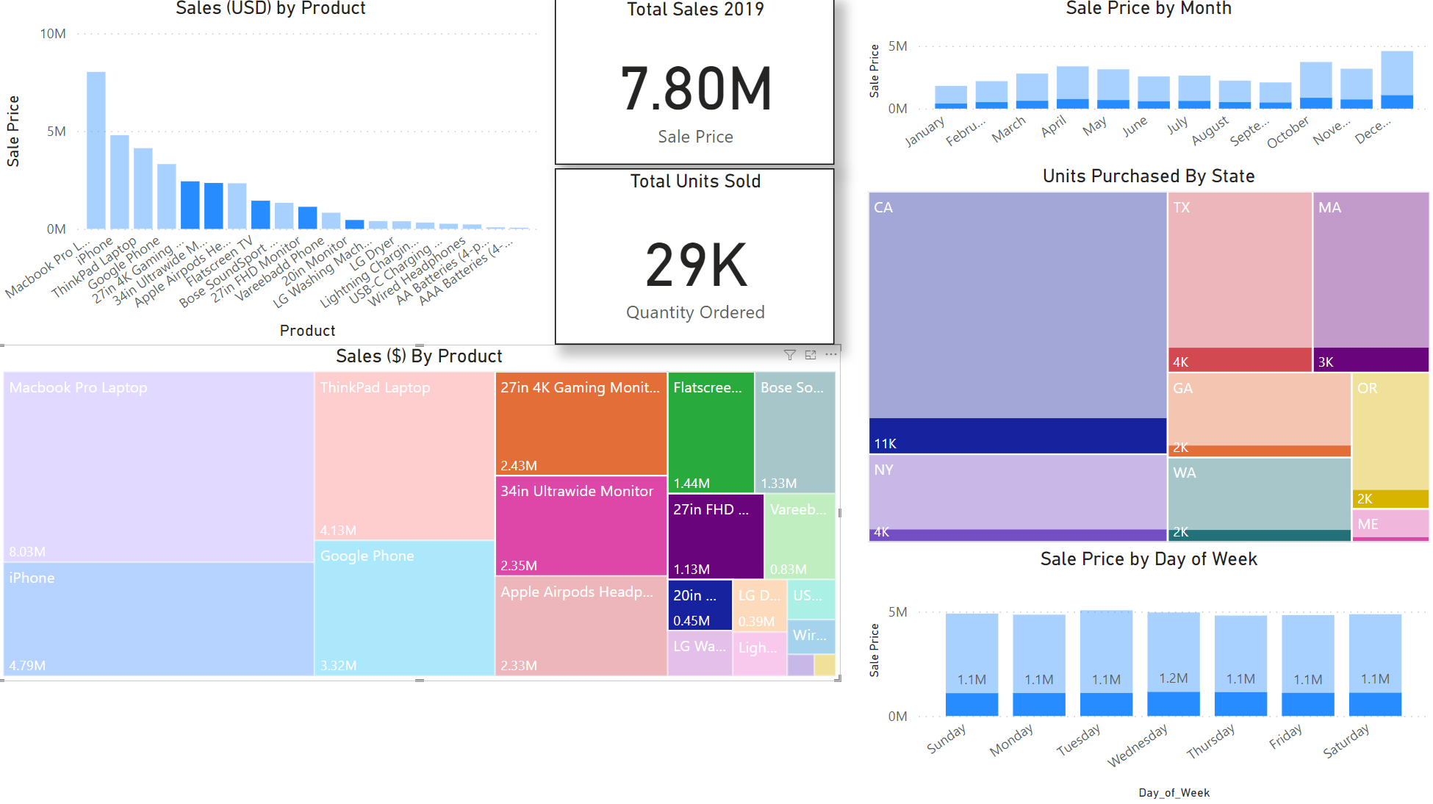
Kaggle Sales Data – Power BI - Monitors
-Below shows sales data specific to monitors sold
-Business insight opportunity: areas with exceptionally low monitor purchase rates where new revenue is waiting to be made.
Monitor sales peak day after overall peak sales.
Source: https://www.kaggle.com/datasets/knightbearr/sales-product-data

Slide 7

Credit Card Fraud Classification
Notes:
DAN F

Slide 8
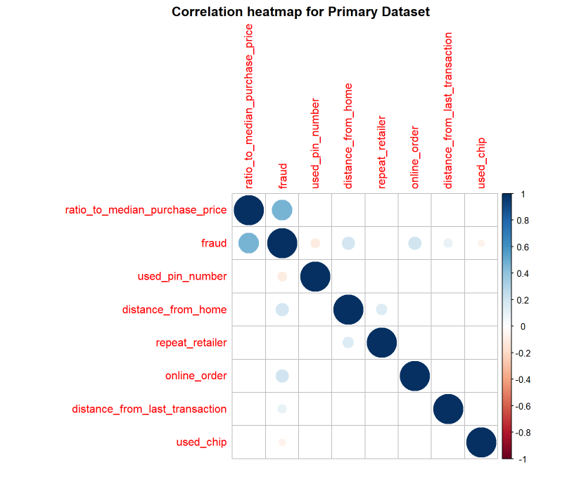
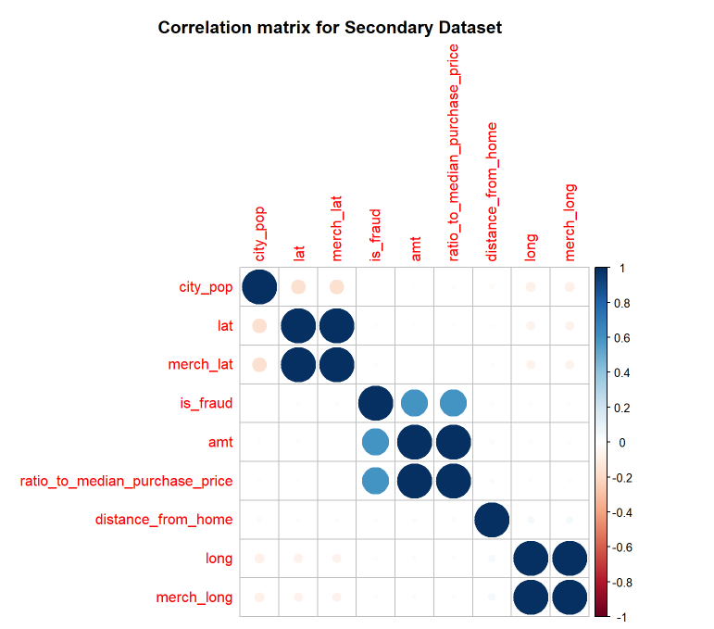
Fraud Datasets
-Using two different credit card fraud datasets, two correlation heat maps were made in R to show the relevance of certain predictors on the outcome (fraudulent or legitimate transactions)
-In the 1st dataset, the ratio to median purchase price was the most significant predictor
-Chip use and pin number use were more correlated with legitimate transactions
Sources:
https://www.kaggle.com/datasets/dhanushnarayananr/credit-card-fraud
https://www.kaggle.com/datasets/kartik2112/fraud-detection

Slide 9

Engineering Data Visualization
Notes:
GEETA

Slide 10
2 Dimensional Heat Transfer In Excel
-Often times, it can be necessary to show changes in a metric over time.
-Below is a simple example of heat conduction for some applied boundary conditions
Convective Boundary
25.5407 | 52 | 74 | 93 | ## | ## | ## | ## | ## | ## | ## | ## | ## | ## | ## | ## | ## | ## | ## | ## | ## | ## | ## | ## | ## | ## | ## | ## | ## | ## | ## | ## | ## | ## | ## | ## | ## | ## | ## | ## | ## | ## | ## | ## | ## | ## | ## | ## | ## | ## | ## | ## | ## | ## | ## | ## | ## | ## | ## | ## | ## | ## | ## | ## | ## | ## | ## | ## | 2266.628
32.43067 | 61 | 86 | ## | ## | ## | ## | ## | ## | ## | ## | ## | ## | ## | ## | ## | ## | ## | ## | ## | ## | ## | ## | ## | ## | ## | ## | ## | ## | ## | ## | ## | ## | ## | ## | ## | ## | ## | ## | ## | ## | ## | ## | ## | ## | ## | ## | ## | ## | ## | ## | ## | ## | ## | ## | ## | ## | ## | ## | ## | ## | ## | ## | ## | ## | ## | ## | ## | 2585.086
44.14693 | 74 | ## | ## | ## | ## | ## | ## | ## | ## | ## | ## | ## | ## | ## | ## | ## | ## | ## | ## | ## | ## | ## | ## | ## | ## | ## | ## | ## | ## | ## | ## | ## | ## | ## | ## | ## | ## | ## | ## | ## | ## | ## | ## | ## | ## | ## | ## | ## | ## | ## | ## | ## | ## | ## | ## | ## | ## | ## | ## | ## | ## | ## | ## | ## | ## | ## | ## | 2864.065
59.63873 | 90 | ## | ## | ## | ## | ## | ## | ## | ## | ## | ## | ## | ## | ## | ## | ## | ## | ## | ## | ## | ## | ## | ## | ## | ## | ## | ## | ## | ## | ## | ## | ## | ## | ## | ## | ## | ## | ## | ## | ## | ## | ## | ## | ## | ## | ## | ## | ## | ## | ## | ## | ## | ## | ## | ## | ## | ## | ## | ## | ## | ## | ## | ## | ## | ## | ## | ## | 3111.857
78.2646 | ## | ## | ## | ## | ## | ## | ## | ## | ## | ## | ## | ## | ## | ## | ## | ## | ## | ## | ## | ## | ## | ## | ## | ## | ## | ## | ## | ## | ## | ## | ## | ## | ## | ## | ## | ## | ## | ## | ## | ## | ## | ## | ## | ## | ## | ## | ## | ## | ## | ## | ## | ## | ## | ## | ## | ## | ## | ## | ## | ## | ## | ## | ## | ## | ## | ## | ## | 3333.485
99.59371 | ## | ## | ## | ## | ## | ## | ## | ## | ## | ## | ## | ## | ## | ## | ## | ## | ## | ## | ## | ## | ## | ## | ## | ## | ## | ## | ## | ## | ## | ## | ## | ## | ## | ## | ## | ## | ## | ## | ## | ## | ## | ## | ## | ## | ## | ## | ## | ## | ## | ## | ## | ## | ## | ## | ## | ## | ## | ## | ## | ## | ## | ## | ## | ## | ## | ## | ## | 3532.293
123.3177 | ## | ## | ## | ## | ## | ## | ## | ## | ## | ## | ## | ## | ## | ## | ## | ## | ## | ## | ## | ## | ## | ## | ## | ## | ## | ## | ## | ## | ## | ## | ## | ## | ## | ## | ## | ## | ## | ## | ## | ## | ## | ## | ## | ## | ## | ## | ## | ## | ## | ## | ## | ## | ## | ## | ## | ## | ## | ## | ## | ## | ## | ## | ## | ## | ## | ## | ## | 3710.654
149.2064 | ## | ## | ## | ## | ## | ## | ## | ## | ## | ## | ## | ## | ## | ## | ## | ## | ## | ## | ## | ## | ## | ## | ## | ## | ## | ## | ## | ## | ## | ## | ## | ## | ## | ## | ## | ## | ## | ## | ## | ## | ## | ## | ## | ## | ## | ## | ## | ## | ## | ## | ## | ## | ## | ## | ## | ## | ## | ## | ## | ## | ## | ## | ## | ## | ## | ## | ## | 3870.323
177.0837 | ## | ## | ## | ## | ## | ## | ## | ## | ## | ## | ## | ## | ## | ## | ## | ## | ## | ## | ## | ## | ## | ## | ## | ## | ## | ## | ## | ## | ## | ## | ## | ## | ## | ## | ## | ## | ## | ## | ## | ## | ## | ## | ## | ## | ## | ## | ## | ## | ## | ## | ## | ## | ## | ## | ## | ## | ## | ## | ## | ## | ## | ## | ## | ## | ## | ## | ## | 4012.631
206.8126 | ## | ## | ## | ## | ## | ## | ## | ## | ## | ## | ## | ## | ## | ## | ## | ## | ## | ## | ## | ## | ## | ## | ## | ## | ## | ## | ## | ## | ## | ## | ## | ## | ## | ## | ## | ## | ## | ## | ## | ## | ## | ## | ## | ## | ## | ## | ## | ## | ## | ## | ## | ## | ## | ## | ## | ## | ## | ## | ## | ## | ## | ## | ## | ## | ## | ## | ## | 4138.605
238.2864 | ## | ## | ## | ## | ## | ## | ## | ## | ## | ## | ## | ## | ## | ## | ## | ## | ## | ## | ## | ## | ## | ## | ## | ## | ## | ## | ## | ## | ## | ## | ## | ## | ## | ## | ## | ## | ## | ## | ## | ## | ## | ## | ## | ## | ## | ## | ## | ## | ## | ## | ## | ## | ## | ## | ## | ## | ## | ## | ## | ## | ## | ## | ## | ## | ## | ## | ## | 4249.04
271.4222 | ## | ## | ## | ## | ## | ## | ## | ## | ## | ## | ## | ## | ## | ## | ## | ## | ## | ## | ## | ## | ## | ## | ## | ## | ## | ## | ## | ## | ## | ## | ## | ## | ## | ## | ## | ## | ## | ## | ## | ## | ## | ## | ## | ## | ## | ## | ## | ## | ## | ## | ## | ## | ## | ## | ## | ## | ## | ## | ## | ## | ## | ## | ## | ## | ## | ## | ## | 4344.55
306.1573 | ## | ## | ## | ## | ## | ## | ## | ## | ## | ## | ## | ## | ## | ## | ## | ## | ## | ## | ## | ## | ## | ## | ## | ## | ## | ## | ## | ## | ## | ## | ## | ## | ## | ## | ## | ## | ## | ## | ## | ## | ## | ## | ## | ## | ## | ## | ## | ## | ## | ## | ## | ## | ## | ## | ## | ## | ## | ## | ## | ## | ## | ## | ## | ## | ## | ## | ## | 4425.597
342.4461 | ## | ## | ## | ## | ## | ## | ## | ## | ## | ## | ## | ## | ## | ## | ## | ## | ## | ## | ## | ## | ## | ## | ## | ## | ## | ## | ## | ## | ## | ## | ## | ## | ## | ## | ## | ## | ## | ## | ## | ## | ## | ## | ## | ## | ## | ## | ## | ## | ## | ## | ## | ## | ## | ## | ## | ## | ## | ## | ## | ## | ## | ## | ## | ## | ## | ## | ## | 4492.516
380.2585 | ## | ## | ## | ## | ## | ## | ## | ## | ## | ## | ## | ## | ## | ## | ## | ## | ## | ## | ## | ## | ## | ## | ## | ## | ## | ## | ## | ## | ## | ## | ## | ## | ## | ## | ## | ## | ## | ## | ## | ## | ## | ## | ## | ## | ## | ## | ## | ## | ## | ## | ## | ## | ## | ## | ## | ## | ## | ## | ## | ## | ## | ## | ## | ## | ## | ## | ## | 4545.532
419.5782 | ## | ## | ## | ## | ## | ## | ## | ## | ## | ## | ## | ## | ## | ## | ## | ## | ## | ## | ## | ## | ## | ## | ## | ## | ## | ## | ## | ## | ## | ## | ## | ## | ## | ## | ## | ## | ## | ## | ## | ## | ## | ## | ## | ## | ## | ## | ## | ## | ## | ## | ## | ## | ## | ## | ## | ## | ## | ## | ## | ## | ## | ## | ## | ## | ## | ## | ## | 4584.766
460.4027 | ## | ## | ## | ## | ## | ## | ## | ## | ## | ## | ## | ## | ## | ## | ## | ## | ## | ## | ## | ## | ## | ## | ## | ## | ## | ## | ## | ## | ## | ## | ## | ## | ## | ## | ## | ## | ## | ## | ## | ## | ## | ## | ## | ## | ## | ## | ## | ## | ## | ## | ## | ## | ## | ## | ## | ## | ## | ## | ## | ## | ## | ## | ## | ## | ## | ## | ## | 4610.242
502.7425 | ## | ## | ## | ## | ## | ## | ## | ## | ## | ## | ## | ## | ## | ## | ## | ## | ## | ## | ## | ## | ## | ## | ## | ## | ## | ## | ## | ## | ## | ## | ## | ## | ## | ## | ## | ## | ## | ## | ## | ## | ## | ## | ## | ## | ## | ## | ## | ## | ## | ## | ## | ## | ## | ## | ## | ## | ## | ## | ## | ## | ## | ## | ## | ## | ## | ## | ## | 4621.892
546.6215 | ## | ## | ## | ## | ## | ## | ## | ## | ## | ## | ## | ## | ## | ## | ## | ## | ## | ## | ## | ## | ## | ## | ## | ## | ## | ## | ## | ## | ## | ## | ## | ## | ## | ## | ## | ## | ## | ## | ## | ## | ## | ## | ## | ## | ## | ## | ## | ## | ## | ## | ## | ## | ## | ## | ## | ## | ## | ## | ## | ## | ## | ## | ## | ## | ## | ## | ## | 4619.548
592.0778 | ## | ## | ## | ## | ## | ## | ## | ## | ## | ## | ## | ## | ## | ## | ## | ## | ## | ## | ## | ## | ## | ## | ## | ## | ## | ## | ## | ## | ## | ## | ## | ## | ## | ## | ## | ## | ## | ## | ## | ## | ## | ## | ## | ## | ## | ## | ## | ## | ## | ## | ## | ## | ## | ## | ## | ## | ## | ## | ## | ## | ## | ## | ## | ## | ## | ## | ## | 4602.942
639.1643 | ## | ## | ## | ## | ## | ## | ## | ## | ## | ## | ## | ## | ## | ## | ## | ## | ## | ## | ## | ## | ## | ## | ## | ## | ## | ## | ## | ## | ## | ## | ## | ## | ## | ## | ## | ## | ## | ## | ## | ## | ## | ## | ## | ## | ## | ## | ## | ## | ## | ## | ## | ## | ## | ## | ## | ## | ## | ## | ## | ## | ## | ## | ## | ## | ## | ## | ## | 4571.694
687.9512 | ## | ## | ## | ## | ## | ## | ## | ## | ## | ## | ## | ## | ## | ## | ## | ## | ## | ## | ## | ## | ## | ## | ## | ## | ## | ## | ## | ## | ## | ## | ## | ## | ## | ## | ## | ## | ## | ## | ## | ## | ## | ## | ## | ## | ## | ## | ## | ## | ## | ## | ## | ## | ## | ## | ## | ## | ## | ## | ## | ## | ## | ## | ## | ## | ## | ## | ## | 4525.301
738.5276 | ## | ## | ## | ## | ## | ## | ## | ## | ## | ## | ## | ## | ## | ## | ## | ## | ## | ## | ## | ## | ## | ## | ## | ## | ## | ## | ## | ## | ## | ## | ## | ## | ## | ## | ## | ## | ## | ## | ## | ## | ## | ## | ## | ## | ## | ## | ## | ## | ## | ## | ## | ## | ## | ## | ## | ## | ## | ## | ## | ## | ## | ## | ## | ## | ## | ## | ## | 4463.115
791.0057 | ## | ## | ## | ## | ## | ## | ## | ## | ## | ## | ## | ## | ## | ## | ## | ## | ## | ## | ## | ## | ## | ## | ## | ## | ## | ## | ## | ## | ## | ## | ## | ## | ## | ## | ## | ## | ## | ## | ## | ## | ## | ## | ## | ## | ## | ## | ## | ## | ## | ## | ## | ## | ## | ## | ## | ## | ## | ## | ## | ## | ## | ## | ## | ## | ## | ## | ## | 4384.312
845.5251 | ## | ## | ## | ## | ## | ## | ## | ## | ## | ## | ## | ## | ## | ## | ## | ## | ## | ## | ## | ## | ## | ## | ## | ## | ## | ## | ## | ## | ## | ## | ## | ## | ## | ## | ## | ## | ## | ## | ## | ## | ## | ## | ## | ## | ## | ## | ## | ## | ## | ## | ## | ## | ## | ## | ## | ## | ## | ## | ## | ## | ## | ## | ## | ## | ## | ## | ## | 4287.858
902.2606 | ## | ## | ## | ## | ## | ## | ## | ## | ## | ## | ## | ## | ## | ## | ## | ## | ## | ## | ## | ## | ## | ## | ## | ## | ## | ## | ## | ## | ## | ## | ## | ## | ## | ## | ## | ## | ## | ## | ## | ## | ## | ## | ## | ## | ## | ## | ## | ## | ## | ## | ## | ## | ## | ## | ## | ## | ## | ## | ## | ## | ## | ## | ## | ## | ## | ## | ## | 4172.45
961.4317 | ## | ## | ## | ## | ## | ## | ## | ## | ## | ## | ## | ## | ## | ## | ## | ## | ## | ## | ## | ## | ## | ## | ## | ## | ## | ## | ## | ## | ## | ## | ## | ## | ## | ## | ## | ## | ## | ## | ## | ## | ## | ## | ## | ## | ## | ## | ## | ## | ## | ## | ## | ## | ## | ## | ## | ## | ## | ## | ## | ## | ## | ## | ## | ## | ## | ## | ## | 4036.428
1023.319 | ## | ## | ## | ## | ## | ## | ## | ## | ## | ## | ## | ## | ## | ## | ## | ## | ## | ## | ## | ## | ## | ## | ## | ## | ## | ## | ## | ## | ## | ## | ## | ## | ## | ## | ## | ## | ## | ## | ## | ## | ## | ## | ## | ## | ## | ## | ## | ## | ## | ## | ## | ## | ## | ## | ## | ## | ## | ## | ## | ## | ## | ## | ## | ## | ## | ## | ## | 3877.652
1088.29 | ## | ## | ## | ## | ## | ## | ## | ## | ## | ## | ## | ## | ## | ## | ## | ## | ## | ## | ## | ## | ## | ## | ## | ## | ## | ## | ## | ## | ## | ## | ## | ## | ## | ## | ## | ## | ## | ## | ## | ## | ## | ## | ## | ## | ## | ## | ## | ## | ## | ## | ## | ## | ## | ## | ## | ## | ## | ## | ## | ## | ## | ## | ## | ## | ## | ## | ## | 3693.306
1156.837 | ## | ## | ## | ## | ## | ## | ## | ## | ## | ## | ## | ## | ## | ## | ## | ## | ## | ## | ## | ## | ## | ## | ## | ## | ## | ## | ## | ## | ## | ## | ## | ## | ## | ## | ## | ## | ## | ## | ## | ## | ## | ## | ## | ## | ## | ## | ## | ## | ## | ## | ## | ## | ## | ## | ## | ## | ## | ## | ## | ## | ## | ## | ## | ## | ## | ## | ## | 3479.56
1229.654 | ## | ## | ## | ## | ## | ## | ## | ## | ## | ## | ## | ## | ## | ## | ## | ## | ## | ## | ## | ## | ## | ## | ## | ## | ## | ## | ## | ## | ## | ## | ## | ## | ## | ## | ## | ## | ## | ## | ## | ## | ## | ## | ## | ## | ## | ## | ## | ## | ## | ## | ## | ## | ## | ## | ## | ## | ## | ## | ## | ## | ## | ## | ## | ## | ## | ## | ## | 3230.983
1307.779 | ## | ## | ## | ## | ## | ## | ## | ## | ## | ## | ## | ## | ## | ## | ## | ## | ## | ## | ## | ## | ## | ## | ## | ## | ## | ## | ## | ## | ## | ## | ## | ## | ## | ## | ## | ## | ## | ## | ## | ## | ## | ## | ## | ## | ## | ## | ## | ## | ## | ## | ## | ## | ## | ## | ## | ## | ## | ## | ## | ## | ## | ## | ## | ## | ## | ## | ## | 2939.403
1392.902 | ## | ## | ## | ## | ## | ## | ## | ## | ## | ## | ## | ## | ## | ## | ## | ## | ## | ## | ## | ## | ## | ## | ## | ## | ## | ## | ## | ## | ## | ## | ## | ## | ## | ## | ## | ## | ## | ## | ## | ## | ## | ## | ## | ## | ## | ## | ## | ## | ## | ## | ## | ## | ## | ## | ## | ## | ## | ## | ## | ## | ## | ## | ## | ## | ## | ## | ## | 2591.435
1488.115 | ## | ## | ## | ## | ## | ## | ## | ## | ## | ## | ## | ## | ## | ## | ## | ## | ## | ## | ## | ## | ## | ## | ## | ## | ## | ## | ## | ## | ## | ## | ## | ## | ## | ## | ## | ## | ## | ## | ## | ## | ## | ## | ## | ## | ## | ## | ## | ## | ## | ## | ## | ## | ## | ## | ## | ## | ## | ## | ## | ## | ## | ## | ## | ## | ## | ## | ## | 2162.475
1600 | ## | ## | ## | ## | ## | ## | ## | ## | ## | ## | ## | ## | ## | ## | ## | ## | ## | ## | ## | ## | ## | ## | ## | ## | ## | ## | ## | ## | ## | ## | ## | ## | ## | ## | ## | ## | ## | ## | ## | ## | ## | ## | ## | ## | ## | ## | ## | ## | ## | ## | ## | ## | ## | ## | ## | ## | ## | ## | ## | ## | ## | ## | ## | ## | ## | ## | ## | 1600
2000 W/m²
1000 W/m²
Iso-thermal Boundary

Slide 11

2 Dimensional Heat Transfer In Excel
-Below is what the prediction looks like while developing to a steady state solution
Convective Boundary
2000 W/m²
1000 W/m²
Iso-thermal Boundary

Slide 12
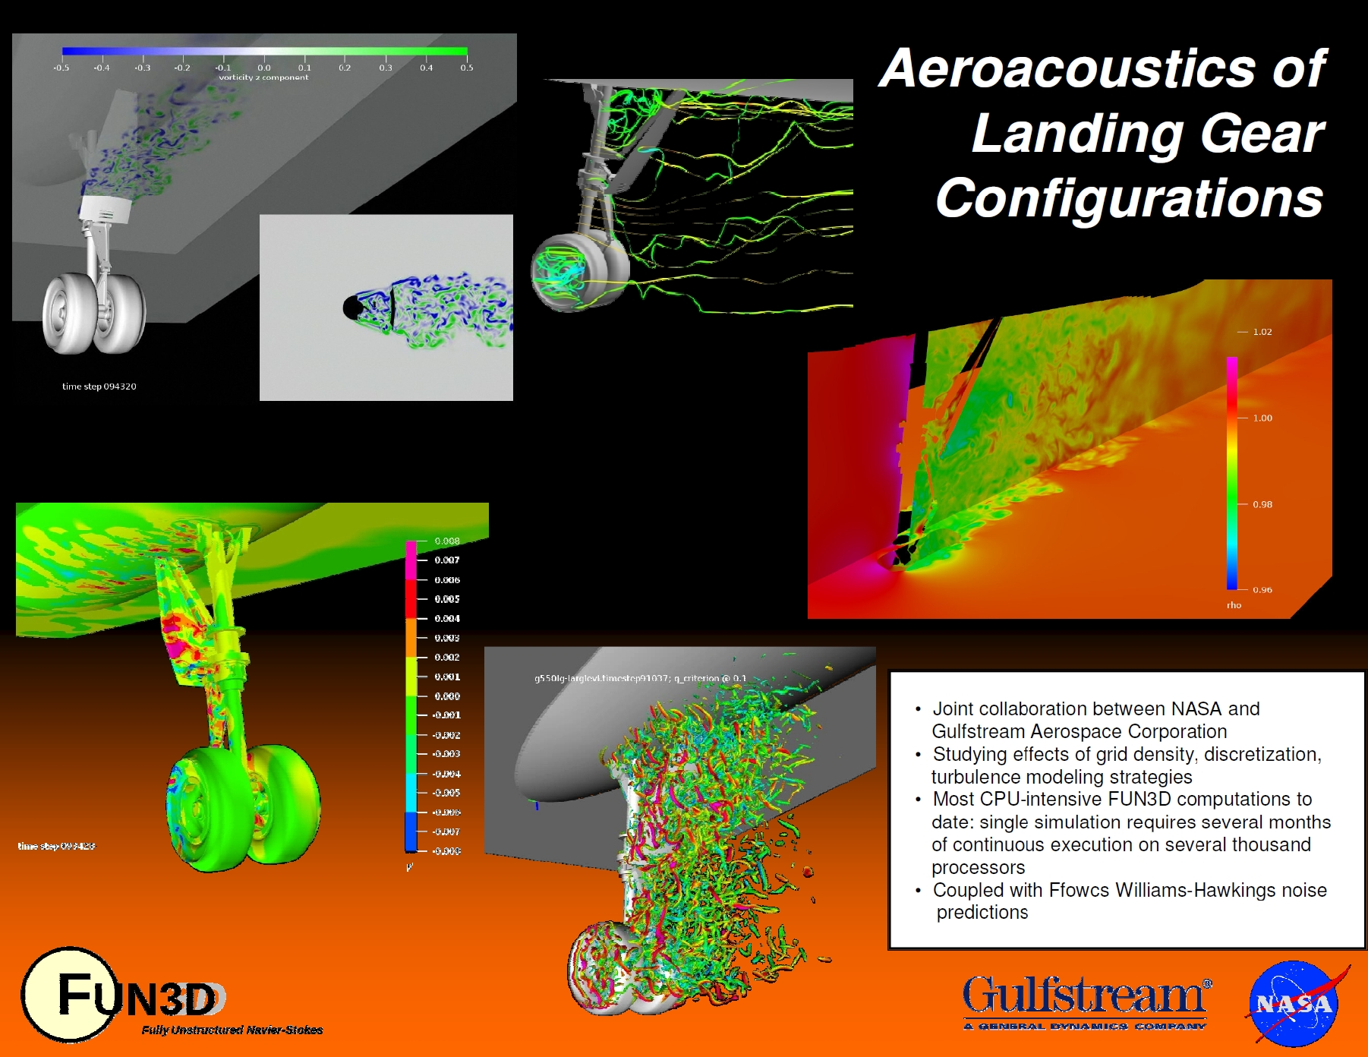
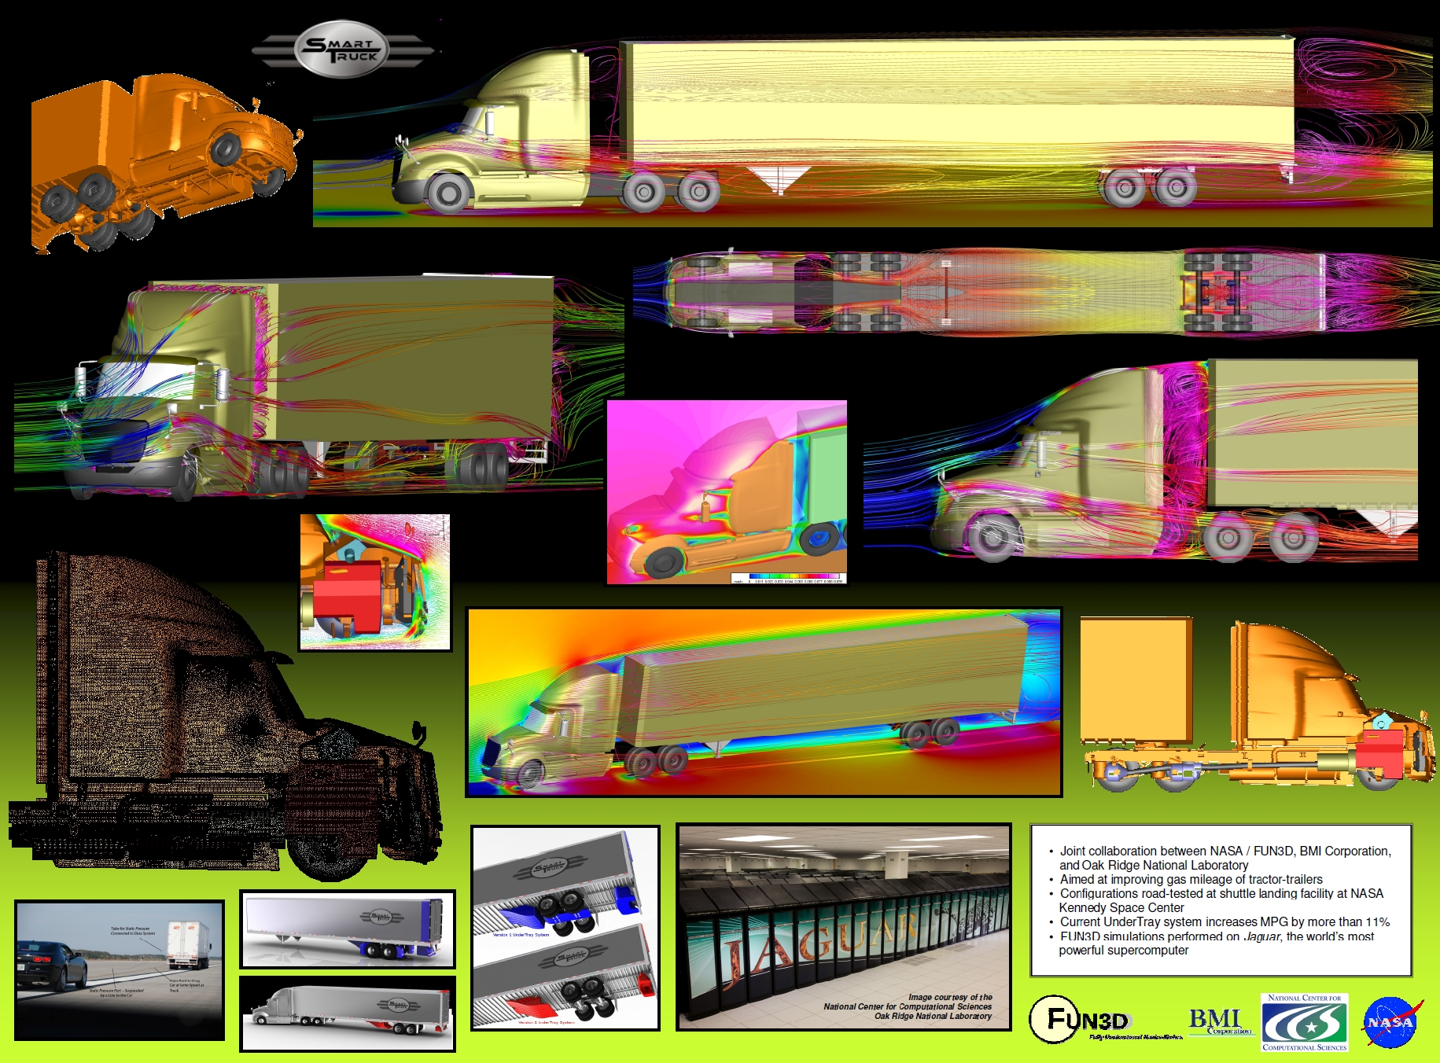
Examples of Computational Fluid Dynamics (CFD)
-All of my previous CFD work is either classified or restricted from sharing outside the company by an NDA. To show examples of what CFD is, I have included some posters below (not my own) to show examples of CFD data visualization similar to what I have done
-I will gladly share descriptions in our zoom call of the CFD data visualizations I have provided to inform necessary stakeholders

Slide 13
Parting notes
-Interactive dashboards not included here, but I can provide those if desired.
-Data visualization experience is composed of business and engineering applications.
-Prior military experience and tenure at defense companies further develops my domain knowledge for mission systems.
I look forward to discussing all of this in detail with you over zoom on Tuesday!

